Slide 1

PERSONAL LOAN CAMPAIGN
By
Lavina Kunder

Slide 2

BACKGROUND
AllLife Bank is a US bank that has a growing customer base. The majority of these customers are liability customers (depositors) with varying sizes of deposits. The number of customers who are also borrowers (asset customers) is quite small, and the bank is interested in expanding this base rapidly to bring in more loan business and in the process, earn more through the interest on loans. In particular, the management wants to explore ways of converting its liability customers to personal loan customers (while retaining them as depositors).
You as a Data scientist at AllLife bank have to build a model that will help the marketing department to identify the potential customers who have a higher probability of purchasing the loan.

Slide 3
PROBLEM DEFINITION
Explore and visualize the dataset.
Data Preprocessing.
Build a Logistic regression model to identify the potential customers who have a higher probability of purchasing the loan, the variables are most significant and which segment of customers should be targeted more.
Testing of Assumptions and Model Performance Evaluation of Logistic Regression Model.
Building a Decision Tree Model.
Testing of Assumptions and Model Performance Evaluation of Decision Tree Model.
Generate a set of insights and recommendations by comparing the models.
EDA on incorrectly predicted data

Slide 4
DATA INFORMATION
The data is for existing customers of AllLife Bank.
Name | Type | Information
ID | Integer | Serial Number
Age | Integer | Age of Customers
Experience | Integer | Work Experience in Years
Income | Integer | Annual Income (in 1000 dollars)
ZIPCode | Integer | Home Address ZIP code.
Family | Integer | Family size of the customer
CCAvg | Float | Avg. credit card spending/month (in 1000$)
Education | Integer | 1:Undergrad; 2:Graduate; 3:Professional
Mortgage | Integer | House Mortgage Value (if any)
Personal_Loan | Integer | 1 : Yes ; 2 : No
Securities_Account | Integer | 1 : Yes ; 2 : No
CD_Account | Integer | 1 : Yes ; 2 : No
Online | Integer | 1 : Yes ; 2 : No
CreditCard | Integer | 1 : Yes ; 2 : No
There are a 5000 rows and 14 columns
There are 13 attributes of type INTEGER.
There is 1 attribute of type FLOAT.
TOTAL : 14 Attributes.

Slide 5
BASIC OBSERVATIONS
The DataSet contains information on 5000 people.
Age ranges from 23 to 67 with the average being 45.
Experience ranges from -3 to 43 years with the average being 20 years.
Income ranges from 8,000 to 224,000 dollars with the average being 64,000 dollars.
ZIP Code highlights the locations of the people.
Family ranges from 1 to 4 members with the average being 2.
CCAvg ranges from 0 to 10,000 dollars with the average around 1,500 dollars
Education ranges from 1 to 3 in levels (1: Undergrad; 2: Graduate;3: Advanced/Professional) with the average around 2 (Graduate)
Mortgage ranges from 0 to 635,000 dollars.

Slide 6
BASIC OBSERVATIONS
Age ranges from 23 to 67 with the average being 45.
Personal_Loan highlights whether customer accepted the personal loan offered in the last campaign? (0: NO, 1:YES) MOST COMMONLY - NO
Securities_Account highlights whether the customer has securities account with the bank? (0: NO, 1:YES) MOST COMMONLY - NO
CD_Account highlights whether the customer has a certificate of deposit (CD) account with the bank? (0: NO, 1:YES) MOST COMMONLY - NO
Online highlights whether thecustomers use internet banking facilities? (0: NO, 1:YES) MOST COMMONLY - YES
CreditCard highlights whether the customer uses a credit card issued by any other Bank (excluding All life Bank)? (0: NO, 1:YES) MOST COMMONLY - NO

Slide 7
DATA PREPROCESSING I
This part of Data Pre-processing is done to understand the DataSet better and for UNIVARIATE and BIVARIATE Exploratory Data Analysis.
Further Data Pre-processing will be done after EDA is complete.
Pre Processing Done :
1) DROP UNNECESSARY COLUMNS (ID and ZIPCode)
2) PROCESSING COLUMNS ('Experience' column shows presence of negative entries (min=-3) which is wrong and needs to be handled appropriately.)

Slide 8
DATA PREPROCESSING I
There are 52 negative entries in the Experience column.
Experience cannot have negative values. We can now take 2 ways:
1) Drop the column
2) Replace the negative values in the column with the mean / median.
Most commonly we prefer the SECOND OPTION as this ensures that dropping the column does not create any trouble in the model building phase as the negative (incorrect values) are a very small part of the attribute and the other data points can create a significant difference in the dataset.
BUT IN THIS CASE :
On checking the CORRELATION TABLE, we notice that AGE and EXPERIENCE have very HIGH POSTIVE CORRELATION (0.994215 ~~ 1).
This means that both these attributes are strongly related and that the variables tend to change in unison. This means the EXPERIENCE can be mirrored by the AGE attribute.
This is why I chose to DROP the EXPERINCE column rather than replace it with the median values

Slide 9
DATA PREPROCESSING I
The Number of columns has now reduced to 11.
Remaining numeric columns seem to be fine and no data cleaning is required

Slide 10
UNIVARIATE ANALYSIS

Slide 11
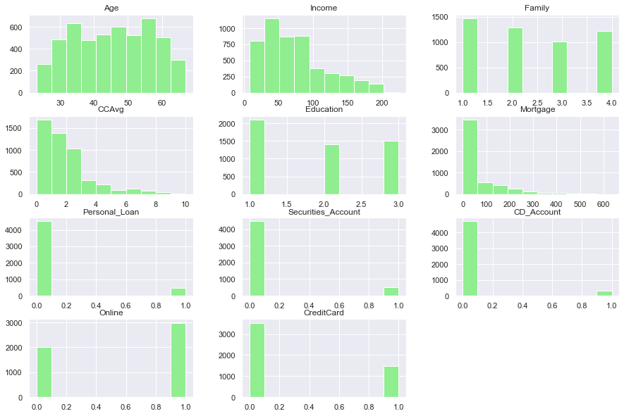
Histogram Plots
Histogram Plots of the various numerical Attributes present in the given Dataset. It shows the frequency of each element within the attribute.

Slide 12
Observations
The high positive Skew in the attributes CCAvg, Mortgage, Personal_Loan, Securities_Account and CD_Account is clearly visible.
Negative Skew in Online can be seen.

Slide 13
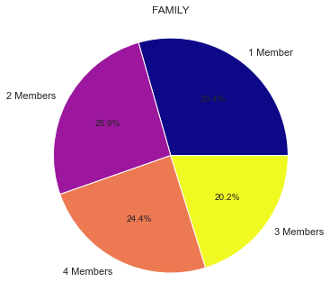
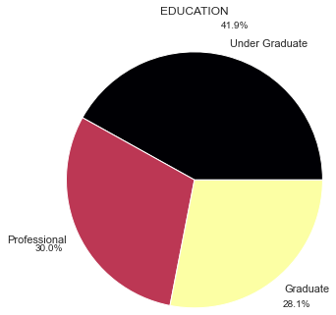
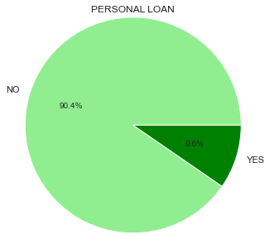
Variable Analysis
The Data Set has more number of families with a size of 1 (29.4%) followed by families with size of 2 (25.9%), size of 4 (24.4%) and size of 3 (20.2%). Mostly evenly distributed.
Most of the customers are Under Graduates followed by Professionals and Graduates.
Most of the customers did NOT accept the personal loan offered in the last campaign.
Less than 10% accepted.

Slide 14
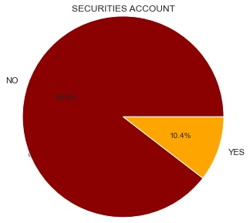
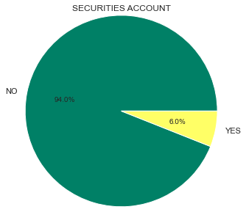
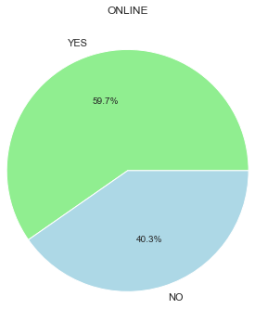
Variable Analysis
Very small percentage of the dataset has a security account with the bank. (10.4%)
Very small percentage of the dataset has a Certificate of Deposit (CD) Account with the bank.(6%)
Almost 60% of the dataset uses the internet banking facilities provided by the bank.

Slide 15
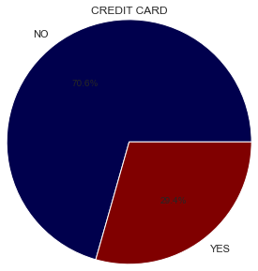
Variable Analysis
70% of the dataset of customers does NOT use a credit card issued by any other Bank (excluding All life Bank)

Slide 16
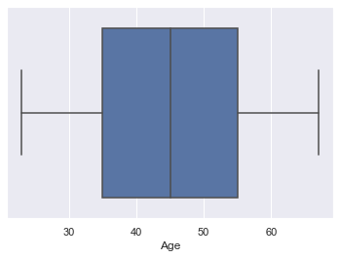
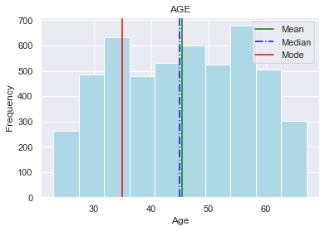
AGE DISTRIBUTION
Mode < Median < Mean
There are NO outliers present.
The box plot shows that it is very evenly distributed around the mean.
The customer ages are in the range of 23 to 67 with average age as 45.
Quarter of the customer population is below 35.

Slide 17
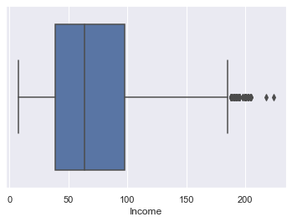
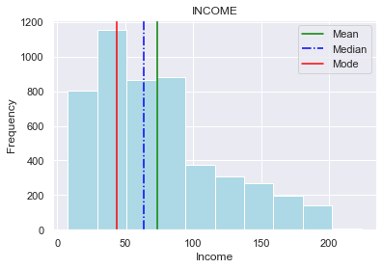
INCOME DISTRIBUTION
Mode < Median < Mean
The boxplot shows a few outliers beyond the upper whisker.
The histogram indicates that the distribution is right-skewed.

Slide 18
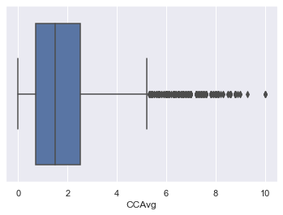
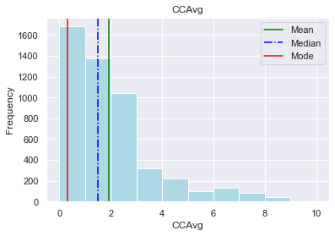
CCAvg DISTRIBUTION
Mode < Median < Mean
Most customers spend 0 to 3000 dollars using credit cards in a month on an average.

Slide 19
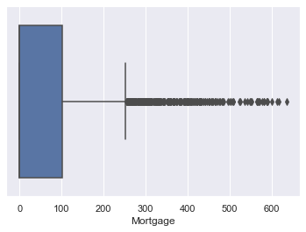
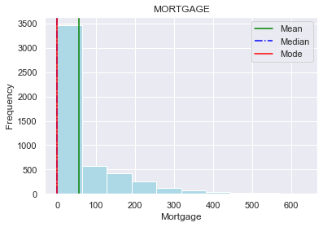
MORTGAGE DISTRIBUTION
Mode = Median < Mean
Most customers have a mortgage spanning 0 to 50,000 dollars
High Postive Skew is visible.

Slide 20
BIVARIATE & MULTIVARIATE ANALYSIS

Slide 21
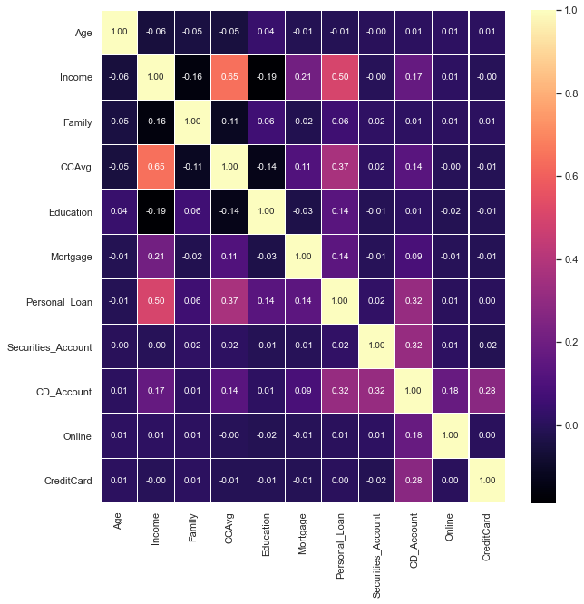
Correlation Heat Map
This Heat Map shows the correlation between the individual attributes. With this we can draw the following inferences :
1) There is distributed correlation between the attributes of this dataset.
2) The Highest Correlation is between 'Income' and 'CCAvg' with 0.65.
3) The Lowest Correlation is between 'Income' and 'Education' with -0.19 (Negative).
4) Since Personal_Loan is our target variable; the correlations of other columns with personal_loan; like age, experience, family, securities_account, online and creditcard have very low correlations.

Slide 22
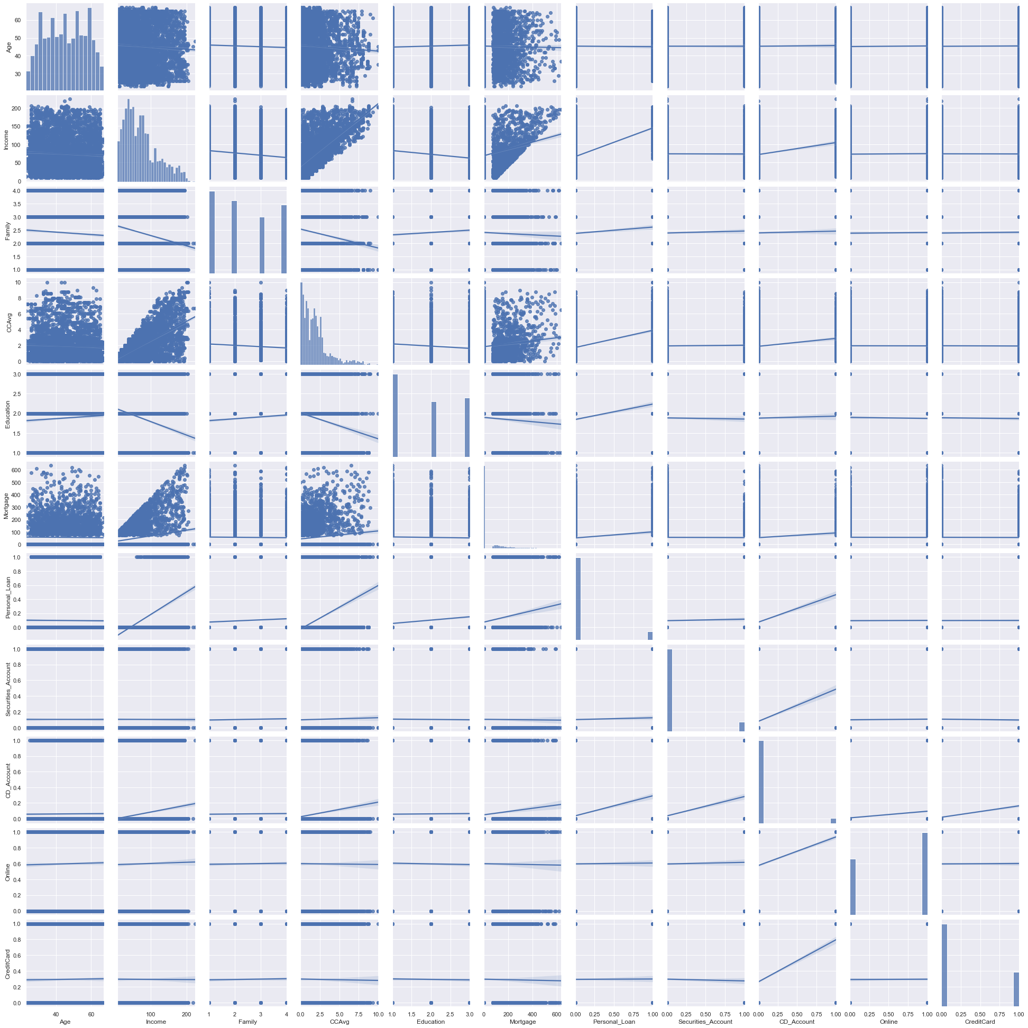
Pair Plot

Slide 23
Pair Plot

Slide 24
Pair Plot
Pairplot to show the relationship between the different variables. It is a more graphical representation of the Correlation Heat Map.
There are more variables in the dataset, but they do not show any significant information on the pairplot as they only take 2 values (0 or 1) and therefore have been excluded from the graph.

Slide 25
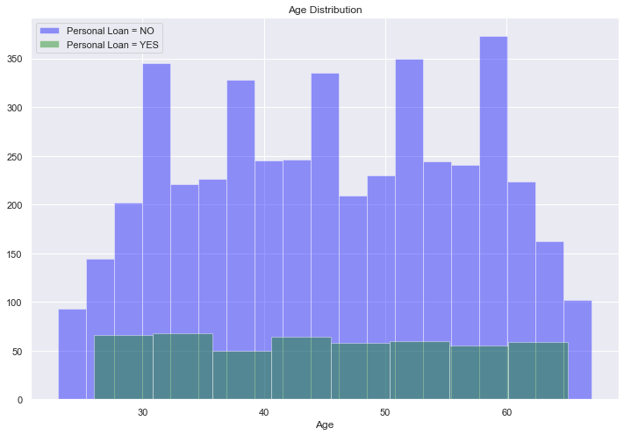
PERSONAL LOAN V/S AGE
OBSERVATIONS
Most of the customers lie in the age group of 30 to 60.
Normally Distributed
As Age increases, tendency to accept a personal loan has decreased.

Slide 26
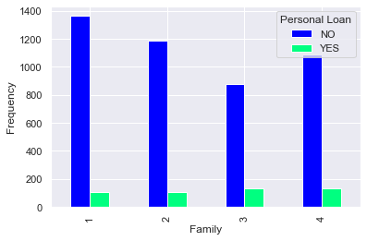
PERSONAL LOAN V/S FAMILY
OBSERVATIONS
Families of larger size prefer personal loans and have accepted it when offered in the last campaign.
Number of Families that did not take the personal loan decrease with increase in family size with the exception of family size of 4 where there is a spike.

Slide 27
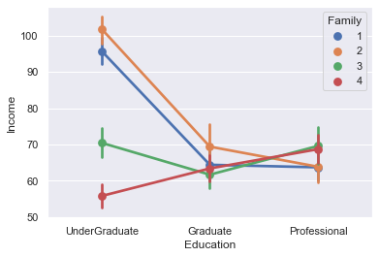
EDUCATION V/S FAMILY V/S INCOME
OBSERVATIONS
UNDERGRADUATES : Family of 2 have highest income followed by family of 1, 3 and 4.
GRADUATES : Family of 2 has the highest income followed by family of 1,4 and 3.
PROFESSIONALS : Family of 3 and 4 have the highest income followed by 1 and 2.
For Family of 1 and 2, there is a constant decrease in income as education increases. For Family of 3, the income decreases and then increases as education level increases and for Family of 4 there is a constant increase in income as the level of education increases.

Slide 28
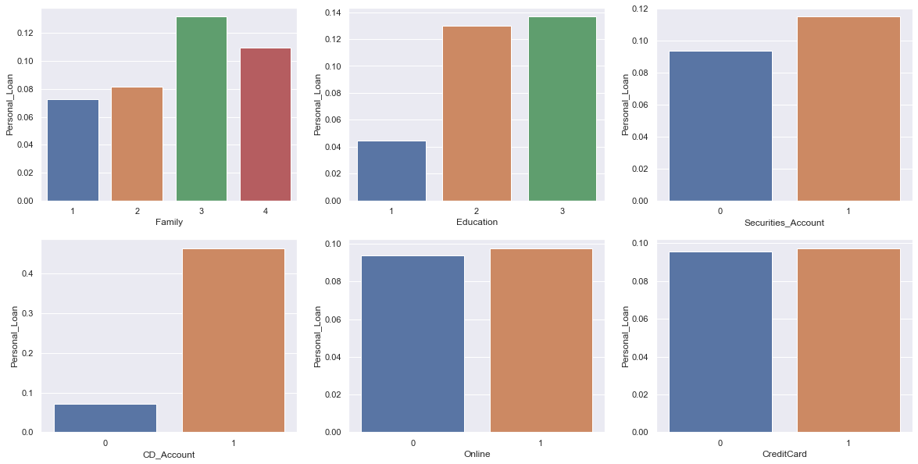
PERSONAL LOAN V/S CATEGORICAL VARIABLES

Slide 29
PERSONAL LOAN V/S CATEGORICAL VARIABLES
OBSERVATIONS
Customers with family size equal to 3 have preffered to accept the personal loan offered in the last campaign.
Customers with Undergraduate degree have less chances of having Personal Loan as compared to other levels of Education. Higher the education level the more the customer is confident and open to opt for personal_loan.
Customers with CD Account and Securities Account have more chances of having Personal Loan.
Difference of usage of Online Facilities and Credit Cards supplied by other banks (YES OR NO) makes no difference to the acceptance of personal loan.

Slide 30
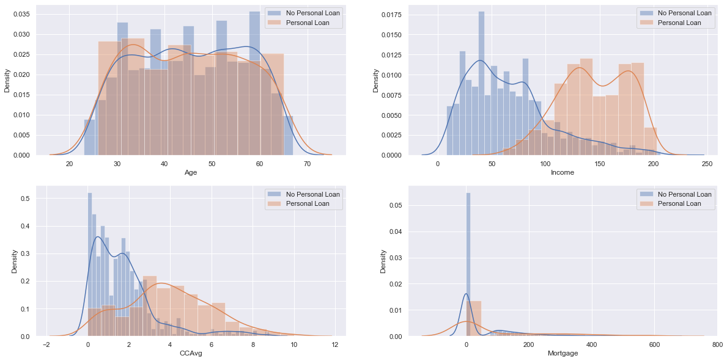
PERSONAL LOAN V/S NUMERICAL VARIABLES

Slide 31
PERSONAL LOAN V/S NUMERICAL VARIABLES
OBSERVATIONS
Personal Loan doesn't show variations with Age.
Higher Income points to a higher chance of having accepted a loan in the previous campaign.
Higher Income shows that spending on credit cards also increases. Although the dataset is heavily concentrated to NO personal loans.
Customers with high Mortgage have accepted for Personal Loans.

Slide 32
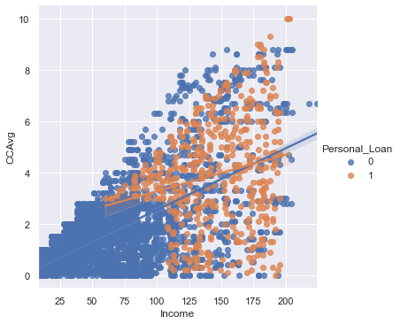
CCAvg V/S PERSONAL LOAN V/S INCOME
OBSERVATIONS
There is an increase in Average spending on credit cards per month as the Income increases.
People opting for Personal Loans have a higher Income Set than those who don't and therefore have higher spending on their Credit Cards as well.

Slide 33
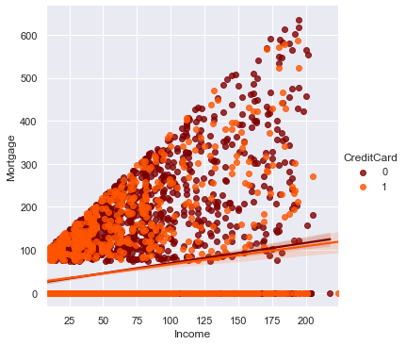
MORTGAGE V/S CREDIT CARD V/S INCOME
OBSERVATIONS
As Income increases Mortgage also increases.
But it is also noticeable that most people with lower income are on the lower side of mortgage.
Most of the dataset is concentrated to the lower mortgage and income.
As income increases, there is an increase in use of Credit Cards by other banks as well. But we can also notice that there is an increase in NO use of credit cards from other banks. This is mainly due to the imbalance in data favouring No credit cards.

Slide 34
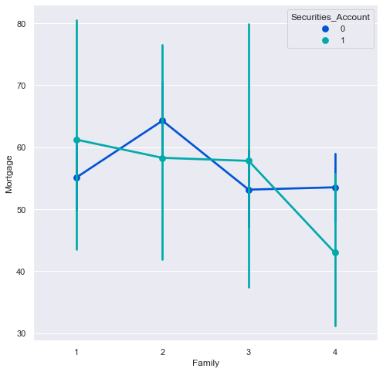
MORTGAGE V/S FAMILY V/S SECURITIES ACCOUNT
OBSERVATIONS
SECURITY ACCOUNT : NO - Family of 2 members have higher mortgage compared to families of other sizes who have relatively the same range of mortgage.
SECURITY ACCOUNT : YES - As Family Size increases, there is a general decrease in Mortgage amount.

Slide 35
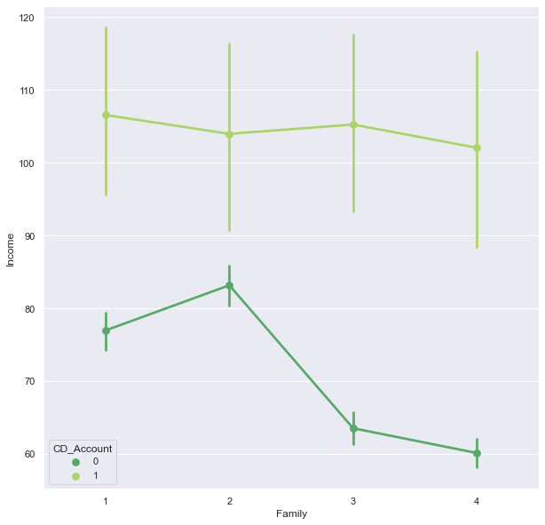
INCOME V/S FAMILY V/S CD ACCOUNT
OBSERVATIONS
Those with a higher income prefer to have a CD Account as compared to those with lower income.
Amongst the lower income families, preference for CD Account is less. 2 member families have been noticed to have a higher income than families of other sizes with 3 and 4 member families with no CD account having very little income.

Slide 36
Key Insights based on EDA
The customer ages are in the range of 23 to 67 with average age as 45.
Quarter of the customer population is below 35.
Most customers spend 0 to 3000 dollars using credit cards in a month on an average.
The Data Set has more number of families with a size of 1 (29.4%) followed by families with size of 2 (25.9%), size of 4 (24.4%) and size of 3 (20.2%)
Most of the customers are Under Graduates followed by Professionals and Graduates.
Most of the customers did NOT accept the personal loan offered in the last campaign.
Less than 10% accepted.
Very small percentage of the dataset has a security account with the bank. (10.4%)
Very small percentage of the dataset has a Certificate of Deposit (CD) Account with the bank.(6%)
Almost 60% of the dataset uses the internet banking facilities provided by the bank.

Slide 37
Key Insights based on EDA
70% of the dataset of customers does NOT use a credit card issued by any other Bank (excluding All life Bank)
Most of the customers lie in the age group of 30 to 60.
As Age increases, tendency to accept a personal loan has decreased.
Families of larger size prefer personal loans and have accepted it when offered in the last campaign.
Number of Families that did not take the personal loan decrease with increase in family size with the exception of family size of 4 where there is a spike.
There is no standard pattern across Family size and Education. For Family of 1 and 2, there is a constant decrease in income as education increases. For Family of 3, the income decreases and then increases as education level increases and for Family of 4 there is a constant increase in income as the level of education increases.
Customers with family size equal to 3 have preffered to accept the personal loan offered in the last campaign.
Customers with Undergraduate degree have less chances of having Personal Loan as compared to other levels of Education

Slide 38
Key Insights based on EDA
Customers with CD Account and Securities Account have more chances of having Personal Loan.
Difference of usage of Online Facilities and Credit Cards supplied by other banks (YES OR NO) makes no difference to the acceptance of personal loan.
Personal Loan doesn't show variations with Age.
Higher Income points to a higher chance of having accepted a loan in the previous campaign.
Higher Income shows that spending on credit cards also increases. Although the dataset is heavily concentrated to NO personal loans.
Customers with high Mortgage have accepted for Personal Loans.
There is an increase in Average spending on credit cards per month as the Income increases.
People opting for Personal Loans have a higher Income Set than those who don't and therefore have higher spending on their Credit Cards as well.
As Income increases Mortgage also increases.

Slide 39
Key Insights based on EDA
But it is also noticeable that most people with lower income are on the lower side of mortgage.
Most of the dataset is concentrated to the lower mortgage and income.
As income increases, there is an increase in use of Credit Cards by other banks as well. But we can also notice that there is an increase in NO use of credit cards from other banks. This is mainly due to the imbalance in data favouring No credit cards.
SECURITY ACCOUNT : NO - Family of 2 members have higher mortgage compared to families of other sizes who have relatively the same range of mortgage.
SECURITY ACCOUNT : YES - As Family Size increases, there is a general decrease in Mortgage amount.
Those with a higher income prefer to have a CD Account as compared to those with lower income.
Amongst the lower income families, preference for CD Account is less. 2 member families have been noticed to have a higher income than families of other sizes with 3 and 4 member families with no CD account having very little income.

Slide 40
Recommendations based on EDA
Marketing strategies targeting families with higher number of members as they show an inclination to purchase loans.
Target younger people for loan purchasing. They will also most likely not pose a liability as they have the time to repay the loan.
Higher degrees of education also prefer loans as compared to the lower ones. Specific strategies targeting highly educated people focusing on the amenities they can purchase the loan for now that they are done with studying and moving into working and settling down.
Customers with CD Accounts and Securities Accounts can be targeted by giving them better interest rates and facilities to pay back the loan as a good will gesture for maintaining existing accounts. This will also further encourage opening of new Securities and CD Accounts.
High Mortgage customers can be targeted for loan purchasing with specific interest rates based on the mortgage amount.
Customers with higher Credit Card Spending can be targeted for loans as that also show higher income and higher spending can be offset with long term loans.

Slide 41
DATA PREPROCESSING II
FEATURE ENGINEERING
This part of Data Preprocessing is done to cater to the Model Building part of the project. It will help in easier development of the Logistic Regression Model and Decision Tree
CONTINUATION : Pre-Processing Done:
3) FIXING MISSING VALUES : No missing values in this DataSet and therefore we can move to the next step.
4) FIXING DATA TYPE : All Data Types are in their correct form.
5) OUTLIERS AND THEIR TREATMENT : Identifying the outliers in all columns and treating them

Slide 42
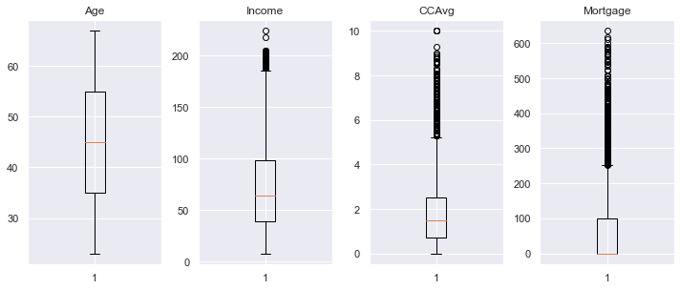
DATA PREPROCESSING II
Age has no outliers. Outliers from Income, CCAvg and Mortgage are important for model building.
No Outlier Treatment Required.

Slide 43
DATA PREPROCESSING II
6) VARIABLE SCALING : For standardizing continuous features. Done using the Standard Scaler package for all the independent variables.
End of Data Pre-processing. Now we can move to Model Building

Slide 44
MODEL BUILDING Logistic Regression

Slide 45
STEP 1: IMPORTING LIBRARIES STEP 2: TRUE AND FALSE RATIO FOR OUTCOME VARIABLE Number of true cases: 480 (9.60%) Number of false cases: 4520 (90.40%) So we have 9.60% people in current data set who have purchased a personal loan and rest of 90.40% who haven't. STEP 3: SPLITTING DATA FOR TRAINING AND TESTING X (Independent Variables) : Age, Income, Family, CCAvg, Education, Mortgage, Securities_Account, CD_Account, Online, CreditCard y (Dependent Variable) : Personal_Loan Train : Test = 70 : 30 STEP 4 : TRUE AND FALSE RATIO FOR SPLIT DATA Training Loan True Values : 331 (9.46%) Training Loan False Values : 3169 (90.54%) Test Loan True Values : 149 (9.93%) Test Loan False Values : 1351 (90.07%)

Slide 46
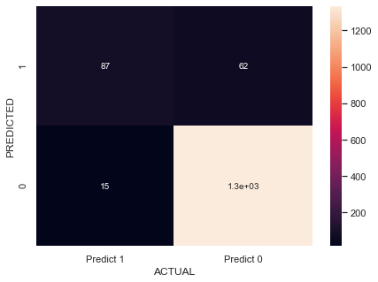
STEP 5 : LOGISTIC REGRESSION Model built using LogisticRegression() CONFUSION MATRIX : True Positives (TP): we correctly predicted that they will take a loan - 87 True Negatives (TN): we correctly predicted that they will not take a loan - 1336 Falsely predict positive : Type I error False Positives (FP): we incorrectly predicted that they will take a loan - 62 Falsely predict negative : Type II error False Negatives (FN): we incorrectly predicted that they will not take a loan - 15 MODEL STATISTICS / FEATURE IMPORTANCE : 1) INTERCEPT : Intercept of the Logistic Regression Model: [-4.57044028]

Slide 47
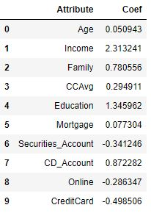
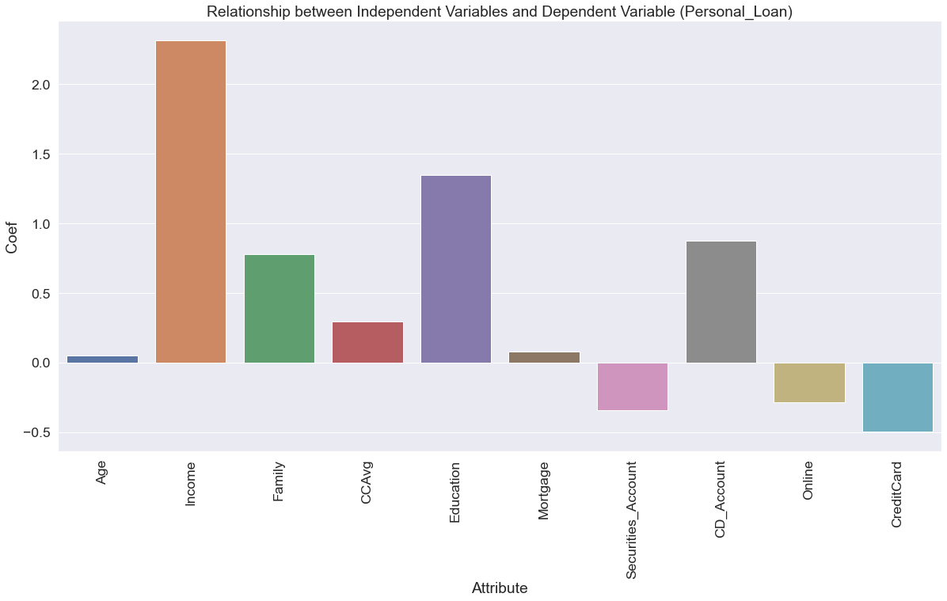
STEP 5 : LOGISTIC REGRESSION 2) COEFFICIENTS OR SLOPE VALUE : In logistic regression, the size of the coefficient for each independent variable gives you the size of the effect that variable is having on your dependent variable, and the sign on the coefficient (positive or negative) gives you the direction of the effect. In regression with multiple independent variables, the coefficient tells you how much the dependent variable is expected to increase (if the coefficient is positive) or decrease (if the coefficient is negative) when that independent variable increases by one, holding all the other independent variables constant.

Slide 48
STEP 5 : LOGISTIC REGRESSION 2) COEFFICIENTS OR SLOPE VALUE : As understood from the graph. Few variables have a strong relationship with Personal Loan. This relationship can either be Positive or Negative. The following are listed in Decreasing Order (Strongest To Weakest Relationship) SIGNIFICANT POSITIVE EFFECT : Income, Education, CD_Account, Family, CC_Avg, Mortgage, Age SIGNIFICANT NEGATIVE EFFECT : Online, Securities_Account, CreditCard STEP 6 : MODEL PERFORMANCE EVALUATION ACCURACY: 0.9486666666666667 PERFORMANCE MEASURES : Precision and Recall Values are more accurate performance metrics as they point out the flaws in the model and the direction of improvement. Recall : Out of all customers that purchased the loan, How many were identified correctly? Precision: Out of all positive predictions, How many were identified correctly? Describe the model better as they provides a better understanding of accuracy

Slide 49
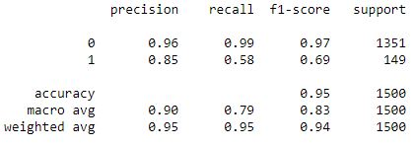
STEP 6 : MODEL PERFORMANCE EVALUATION PERFORMANCE MEASURES : Observations f1-score although lower than accuracy; is still a decent score. It gives an idea as to the precision and recall values. RECALL = 58% Out of all the customers who would actually buy the loan, 58% were correctly predicted to be positive (would buy the personal loan). This means that the bank is missing on 42% of potential customers resulting in losses and additional costs for marketing to that customer base. PRECISION = 85% 85% of precision value means out of all positively predicted customers (who would buy the personal loan) 85% were correctly predicted which is a good score.

Slide 50
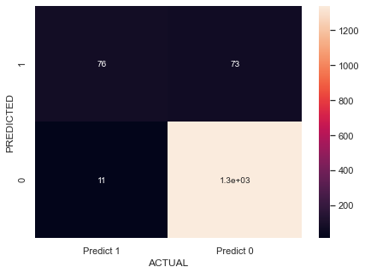
STEP 7 : MODEL PERFORMANCE IMPROVEMENT Using MinMaxScaler() for scaling we drew up another Logistic Regression Model. CONFUSION MATRIX : ACCURACY: 0.944 PERFORMANCE MEASURES : f1-score although lower than accuracy; is still a decent score. It gives an idea as to the precision and recall values. RECALL = 51% PRECISION = 87%

Slide 51
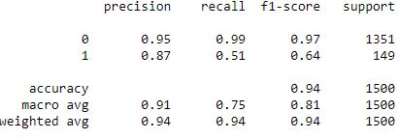
STEP 7 : MODEL PERFORMANCE IMPROVEMENT PERFORMANCE MEASURES : As we can see, although the precision score improved by 2%, the recall fell by 7%. CONCLUSION : We can safely say that the previous model (StandardScaler) had the best model performance.

Slide 52
MODEL BUILDING Decision Tree

Slide 53
STEP 1: IMPORTING LIBRARIES STEP 2 : SPLITTING DATA FOR TRAINING AND TESTING X (Independent Variables) : Age, Income, Family, CCAvg, Education, Mortgage, Securities_Account, CD_Account, Online, CreditCard y (Dependent Variable) : Personal_Loan Train : Test = 70 : 30 STEP 3 : BUILDING DECISION TREE MODEL Using DecisionTreeClassifier() STEP 4 : VISUALIZING THE DECISION TREE MODEL

Slide 54
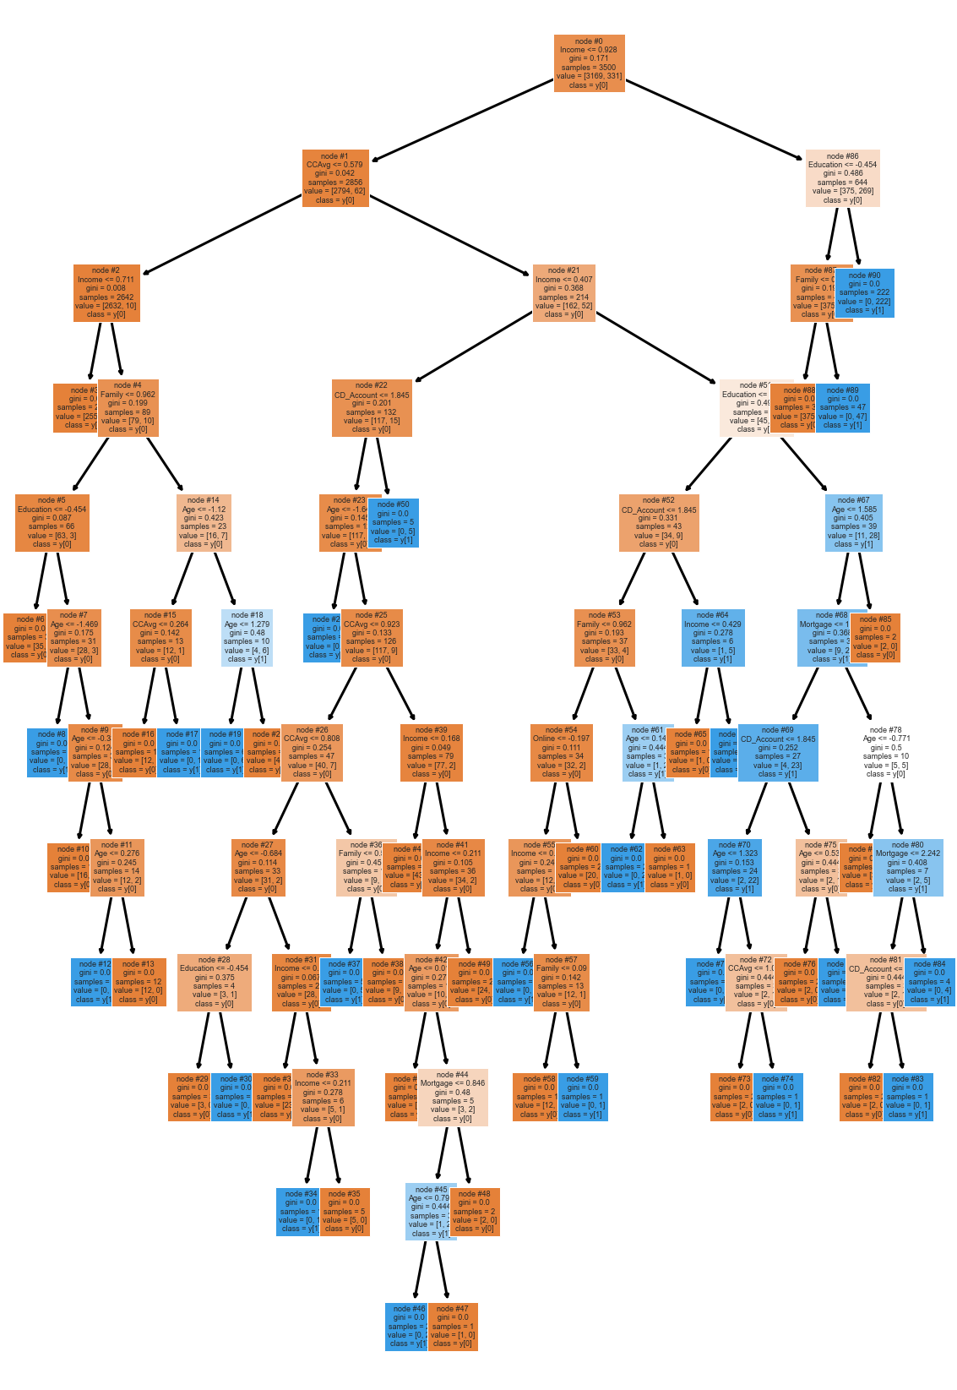
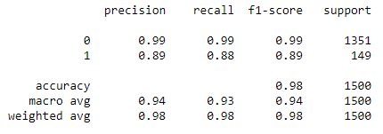
STEP 4 : VISUALIZING THE DECISION TREE MODEL STEP 5 : MODEL PERFORMANCE EVALUATION ACCURACY: Accuracy on training set : 1.0 Accuracy on test set : 0.9773333333333334 PERFORMANCE MEASURES f1-score although lower than accuracy; is still a decent score. It gives an idea as to the precision and recall values. RECALL = 88% PRECISION = 89% The Recall and Precision values are very high showing that the Decision tree Classifier is a great model.

Slide 55
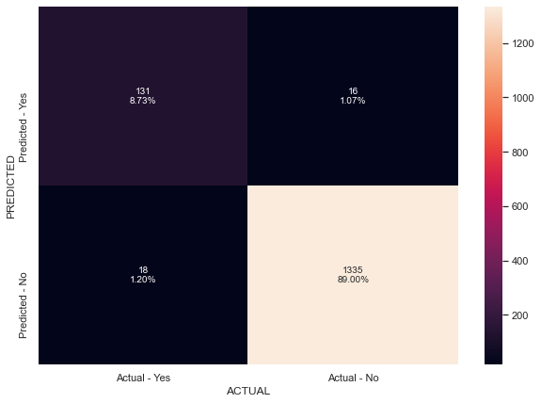
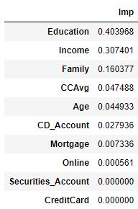
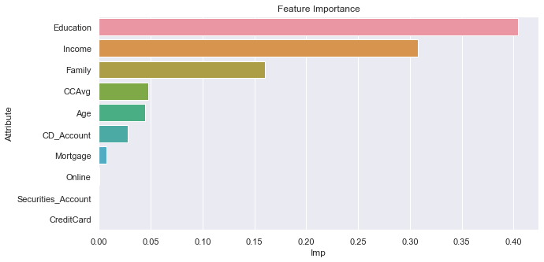
STEP 5 : MODEL PERFORMANCE EVALUATION CONFUSION MATRIX : True Positives (TP): we correctly predicted that they will take a loan - 131 True Negatives (TN): we correctly predicted that they will not take a loan - 1335 Falsely predict positive : Type I error False Positives (FP): we incorrectly predicted that they will take a loan - 16 Falsely predict negative : Type II error False Negatives (FN): we incorrectly predicted that they will not take a loan - 18 FEATURE IMPORTANCE: The importance of a feature is computed as the (normalized) total reduction of the criterion brought by that feature. It is also known as the Gini importance

Slide 56
STEP 5 : MODEL PERFORMANCE EVALUATION FEATURE IMPORTANCE: From the graph, we can see that Education has the highest feature importance followed by Income, Family, CCAvg, Age, CD_Account and Mortgage. Online, Securities_Account and CreditCard hold negligible feature importance. OBSERVATIONS: As we can see this model is very complex and difficult to understand. We can also say that this model tends to overfit. To avoid this, we can PRUNE the decision tree to avoid overfitting and also for ease of understanding. STEP 6 : MODEL PERFORMANCE IMPROVEMENT METHOD 1 : MAX DEPTH In general, the deeper you allow your tree to grow, the more complex your model will become because you will have more splits and it captures more information about the data and this is one of the root causes of overfitting. Let's try Limiting the max_depth of tree to 3

Slide 57
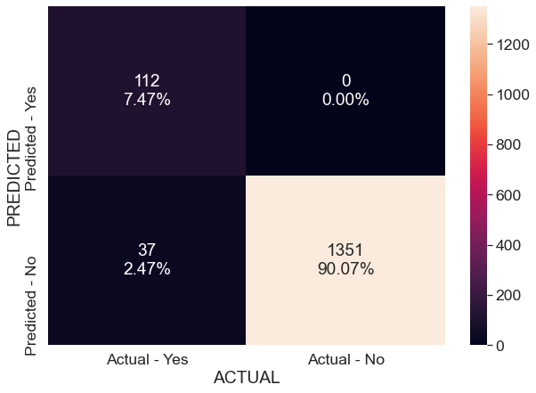
STEP 6 : MODEL PERFORMANCE IMPROVEMENT METHOD 1 : MAX DEPTH In general, the deeper you allow your tree to grow, the more complex your model will become because you will have more splits and it captures more information about the data and this is one of the root causes of overfitting. Let's try Limiting the max_depth of tree to 3 CONFUSION MATRIX : True Positives (TP): we correctly predicted that they will take a loan - 112 True Negatives (TN): we correctly predicted that they will not take a loan - 1351 Falsely predict positive : Type I error False Positives (FP): we incorrectly predicted that they will take a loan - 0 Falsely predict negative : Type II error False Negatives (FN): we incorrectly predicted that they will not take a loan – 37 ACCURACY: Accuracy on training set : 0.9822857142857143 Accuracy on test set : 0.9753333333333334

Slide 58
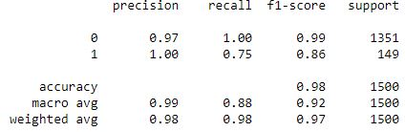
STEP 6 : MODEL PERFORMANCE IMPROVEMENT METHOD 1 : MAX DEPTH PERFORMANCE MEASURES: Training Set Values RECALL = 75% Out of all the customers who would actually buy the loan, 75% were correctly predicted to be positive (would buy the personal loan). This means that the bank is missing on 25% of potential customers resulting in losses and additional costs for marketing to that customer base. PRECISION = 100% 100% precision value means out of all positively predicted customers (who would buy the personal loan) 100% were correctly predicted which is BEST POSSIBLE VALUE. The Recall and Precision values are very high showing that the Decision tree Classifier is an excellent model. We now have a model that doesn't overfit and has the best possible precision value.

Slide 59
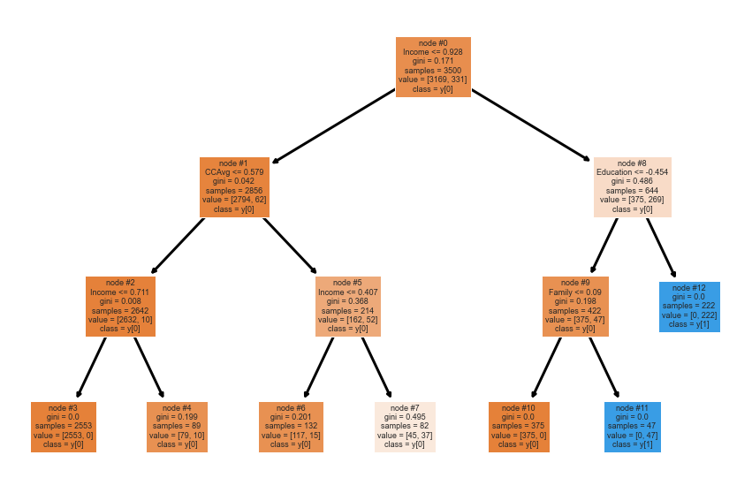
STEP 6 : MODEL PERFORMANCE IMPROVEMENT METHOD 1 : MAX DEPTH VISUALIZING DECISION TREE The tree is much more readable and understandable now, Although the recall value has fallen by quite a bit.

Slide 60
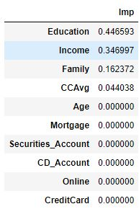
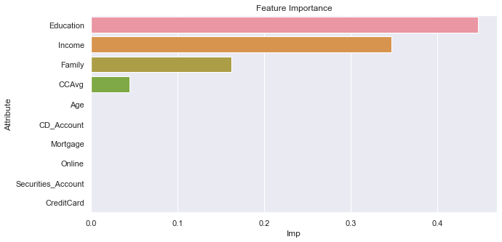
STEP 6 : MODEL PERFORMANCE IMPROVEMENT METHOD 1 : MAX DEPTH FEATURE IMPORTANCE From this graph, we can see that Education has the highest feature importance followed by Income, Family and CCAvg. Age, CD_Account, MortgageOnline, Securities_Account and CreditCard hold negligible feature importance. Which is a huge change from that in the previous model. That's why we will go for pre pruning using grid search, maybe setting max_depth to 3 is not good enough It is bad to have a very low depth because your model will underfit Let's see how to find the best values

Slide 61
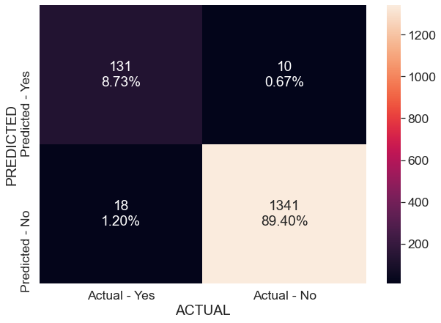
STEP 6 : MODEL PERFORMANCE IMPROVEMENT METHOD 2 : GRID SEARCH USING HYPERPARAMETER Grid search is a tuning technique that attempts to compute the optimum values of hyperparameters. The parameters of the estimator/model used to apply these methods are optimized by cross-validated grid-search over a parameter grid. CONFUSION MATRIX : True Positives (TP): we correctly predicted that they will take a loan - 131 True Negatives (TN): we correctly predicted that they will not take a loan - 1341 Falsely predict positive : Type I error False Positives (FP): we incorrectly predicted that they will take a loan - 10 Falsely predict negative : Type II error False Negatives (FN): we incorrectly predicted that they will not take a loan – 18 ACCURACY: Accuracy on training set : 0.9897142857142858 Accuracy on test set : 0.9813333333333333

Slide 62
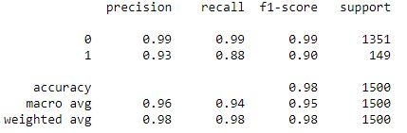
STEP 6 : MODEL PERFORMANCE IMPROVEMENT METHOD 2 : GRID SEARCH USING HYPERPARAMETER PERFORMANCE MEASURES: Training Set Values RECALL = 88% Out of all the customers who would actually buy the loan, 88% were correctly predicted to be positive (would buy the personal loan). This means that the bank is missing on 12% of potential customers resulting in losses and additional costs for marketing to that customer base. PRECISION = 93% 93% precision value means out of all positively predicted customers (who would buy the personal loan) 93% were correctly predicted which is an excellent value The Recall and Precision values are very high showing that the Decision tree Classifier with Hyperparameter tuning using gridsearch is an excellent model. We not have a model that doesn't overfit and have great recall and precision values

Slide 63
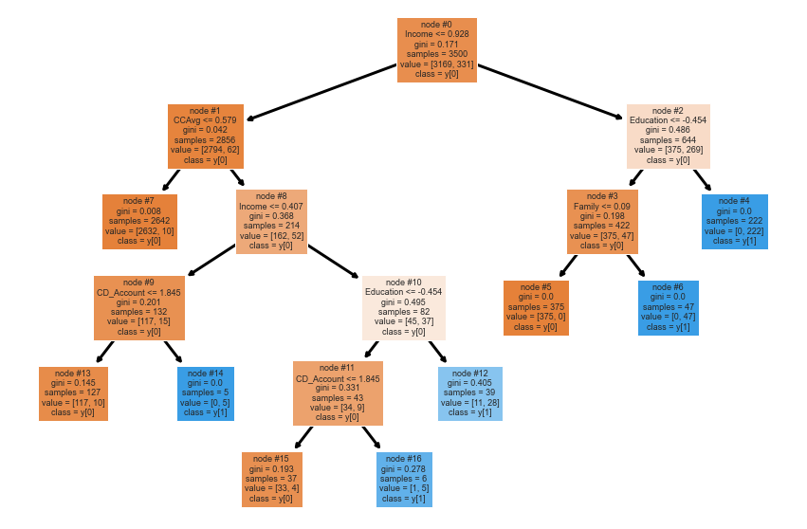
STEP 6 : MODEL PERFORMANCE IMPROVEMENT METHOD 2 : GRID SEARCH USING HYPERPARAMETER VISUALIZING DECISION TREE The tree is much more readable and understandable now. We also have good precision and recall values.

Slide 64
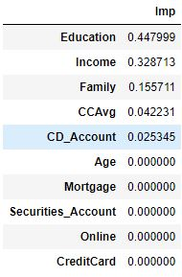
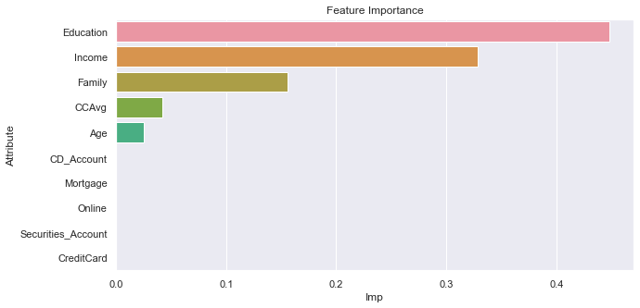
STEP 6 : MODEL PERFORMANCE IMPROVEMENT METHOD 2 : GRID SEARCH USING HYPERPARAMETER FEATURE IMPORTANCE From this graph, we can see that Education has the highest feature importance followed by Income, Family, CCAvg and Age CD_Account, MortgageOnline, Securities_Account and CreditCard hold negligible feature importance. Which is a huge change from the original model. Age now has more importance than in the model using max_depth pruning.

Slide 65
ACTIONABLE INSIGHTS & RECOMMENDATIONS

Slide 66
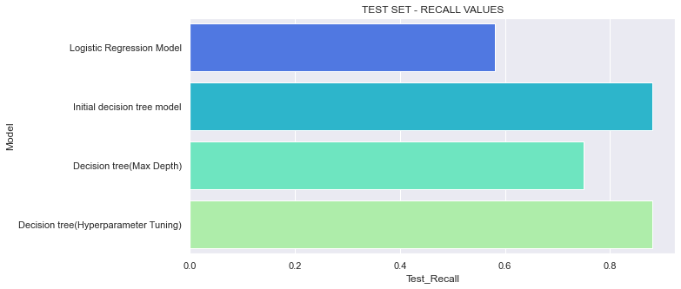

COMPARING ALL THE MODELS

Slide 67

COMPARING ALL THE MODELS
With this table we can conclude that Decision tree with Hyperparameter Tuning is the model with the best possible Precision and Accuracy Values.

Slide 68
KEY TAKEAWAYS FOR THE BUSINESS.
These are a few points the business can focus on to improve their chances of customers purchasing a personal loan.
Since Education is a very important feature across all models, the business should focus on the different levels of education. A special loan package can be crafted targeting each level of education based on how inclined they are to purchase the loan and their ability to pay it back.
Since higher income customers are more likely to buy a loan, special interest rates can be applied to them which would be slightly higher that normal rates as they would hold the capacity to pay them back whereas the lower income customers can have lower interest rates to encourage them to purchase loans.
Personalized Loans based on different needs like Home, Car, Travel, etc.
Loan Packages targeting families of different sizes with specific attention drawn to loans for children's education, etc. for families of bigger sizes and with children.

Slide 69
KEY TAKEAWAYS FOR THE BUSINESS.
Customers with higher Credit Card Spending Averages can be targeted by offering them cashbacks on their credit cards purchases based on whether or not they have Securities Account, CD Account or Credit Cards with the bank.
Those with lower spending average can also be targeted by offering them credit cards with the purchase of loans which provide specific benefits based on the retail stores they are used in.
Identifying the Age Demographic more likely to purchase loans and creating specific marketing campaigns that would draw their attention.

Slide 70
THANK YOU

